Slide 1
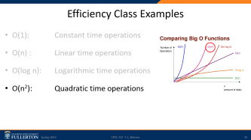
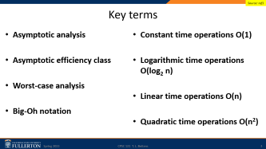
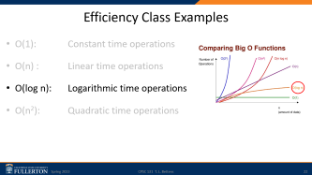
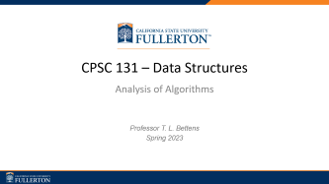
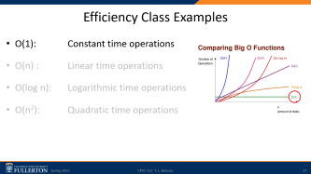
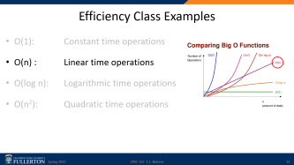
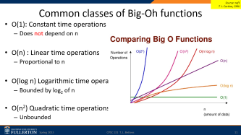
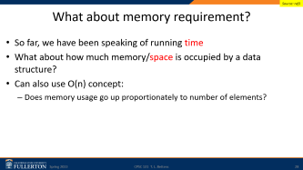

Slide 2


CPSC 131 – Data Structures
Analysis of Algorithms
Professor T. L. Bettens
Spring 2023

Slide 3
Key terms
Source: ref1
Asymptotic analysis
Asymptotic efficiency class
Worst-case analysis
Big-Oh notation
Constant time operations O(1)
Logarithmic time operations O(log₂ n)
Linear time operations O(n)
Quadratic time operations O(n²)

Slide 4
Comparing data structures
Source: ref1, ref2
Is a doubly linked list better than a singly linked list?
What does it mean to be better? Under what conditions? What does “good” mean?
Running time? Memory used?
Usually means a trade-off
Two approaches to answering this question:
Option 1: Experimental analysis
Option 2: Asymptotic analysis

Slide 5
Comparing
Source: ref1
Data Structure
Operations
Arrays
Singly linked lists
Doubly linked lists
Binary Trees
Hash Tables
Create empty
Get front element
Add or remove front element
Get back element
Add or remove back element
Clear data structure
Get/add/remove i^{th} element

Slide 6
Comparing
Source: ref2
This course’s goal: the design of “good” data structures and algorithms
Data structures: systematic way of organizing and accessing data
Algorithms: Step-by-step procedure for performing a task in a finite time.
What does “good” mean?
Running time—fast
Space usage—small
Usually means a trade-off
Faster often requires more memory for extra pointers
Smaller often requires more complex algorithms
Essential point: Running time increases with input size

Slide 7
Option 1: Experimental Analysis
Source: ref1
Implement the two data structures
Implement a main function that loads both with same data
Call the same data structure operations on both
Insert elements
Delete elements …
Measure time spent by each data structure

Slide 8
Option 1: Experimental Analysis
Source: ref1
Problems
Can do experiments only a limited data set
Other factors impact running time:
What other programs are running on the computer
Does the running time depend on the computer itself?
Do the results hold on a different computer?
Does the running time depend on the implementation?
Do the results hold on a different programming language?

Slide 9
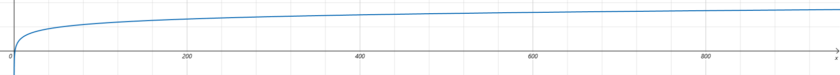
Option 2: Asymptotic Analysis
Source: ref1
Analysis without actually running any code
Done at the desktop looking at source code
Asymptotic: approaching a value closely
Key idea:
We are interested in running time for large data sets
How fast will running time increase as we increase data size?
Rate of increase
Look for the loops!
Time
Size

Slide 10
Option 2: Asymptotic Analysis
Source: ref1
Most important factor?
Number of elements in the data structure (i.e., size)
Represent this by n
Analysis
How does running time increase in terms of n?

Slide 11
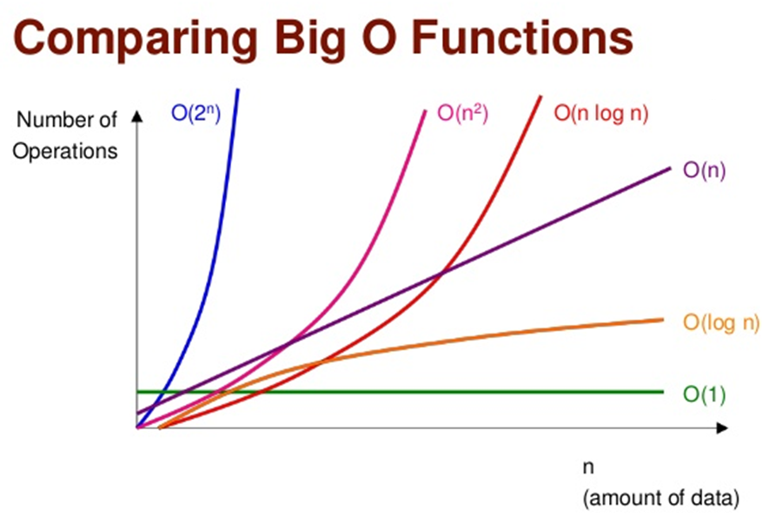
Common classes of Big-Oh functions
Source: ref1
T. J. Cortina, CMU
O(1): Constant time operations
Does not depend on n
O(n) : Linear time operations
Proportional to n
O(log n) Logarithmic time operations
Bounded by log₂ of n
O(n²) Quadratic time operations
Unbounded

Slide 12
Efficiency Class Examples
O(1): Constant time operations
O(n) : Linear time operations
O(log n): Logarithmic time operations
O(n²): Quadratic time operations

Slide 13
Efficiency Class Examples
O(1): Constant time operations
O(n) : Linear time operations
O(log n): Logarithmic time operations
O(n²): Quadratic time operations

Slide 14
Efficiency Class Example: O(n) Printing a list
Source: ref1
Look for the loops!
Consider a list of n elements
for (const auto & value : list )
{
cout << value << endl;
}
How many steps did we have to do?
Too complex!
Do the number of steps increase in proportion to n?

Slide 15
Efficiency Class Example: O(n) Printing a list
Source: ref1
Yes! number of operations increase in proportion to n
“Printing all elements in a list takes on the order of n”
Written as O(n)
Also commonly spoken as “Oh of n”

Slide 16
Efficiency Class Example: O(n) Printing a list
Source: ref1
But what about the fact that we had to
initialize the loop
Printing required cout
We also printed endl
…
Don’t care about constant factors
Focus on the big picture
Not details like initialization
Worst-case analysis

Slide 17
Efficiency Class Examples
O(1): Constant time operations
O(n) : Linear time operations
O(log n): Logarithmic time operations
O(n²): Quadratic time operations

Slide 18
Efficiency Class Example: O(1) Algorithm Independent of “n”
Return the value of an attribute (e.g., getters)
std::size_t size() { return _size; }
Fixed length loops
for (unsigned int i = 0; i < 10; ++i )
{
cout << i << '\n';
}
Math expressions
limit = 2 * sin(x+y) + 3 * z;
Look for the loops!
But make sure the loops are dependent on 'n'

Slide 19
Efficiency Class Example: O(1) Amortization
Source: ref2
Financial: Amortization is paying off an amount owed over time by making planned, incremental payments of principal and interest.
Computer Science: To even out the costs of running an algorithm over many iterations, so that high-cost iterations are much less frequent than low-cost iterations, which lowers the average running time per iteration.

Slide 20
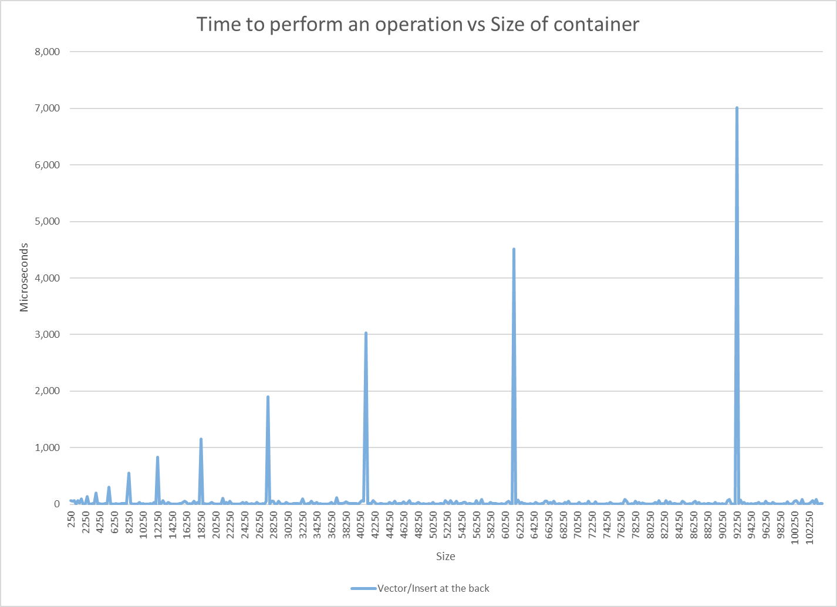
Efficiency Class Example: Amortized O(1)

Slide 21
Efficiency Class Example: Amortized O(1) Increase the Extension Size, Reduce the Number of Copy Operations
Source: ref2
 | Extend by 1 |  |  | Double Each Extension
Insert # | Size | Capacity | Copies | Size | Capacity | Copies
1 | 1 | 1 | 0 | 1 | 1
2 | 2 | 2 | 1 | 2 | 2 | 1
3 | 3 | 3 | 2 | 3 | 4 | 2
4 | 4 | 4 | 3 | 4 | 4
5 | 5 | 5 | 4 | 5 | 8 | 4
6 | 6 | 6 | 5 | 6 | 8
7 | 7 | 7 | 6 | 7 | 8
8 | 8 | 8 | 7 | 8 | 8
9 | 9 | 9 | 8 | 9 | 16 | 8
10 | 10 | 10 | 9 | 10 | 16
11 | 11 | 11 | 10 | 11 | 16
12 | 12 | 12 | 11 | 12 | 16
13 | 13 | 13 | 12 | 13 | 16
14 | 14 | 14 | 13 | 14 | 16
15 | 15 | 15 | 14 | 15 | 16
16 | 16 | 16 | 15 | 16 | 16
 | Total Copies |  | 120 | Total Copies |  | 15

Slide 22
Efficiency Class Examples
O(1): Constant time operations
O(n) : Linear time operations
O(log n): Logarithmic time operations
O(n²): Quadratic time operations

Slide 23
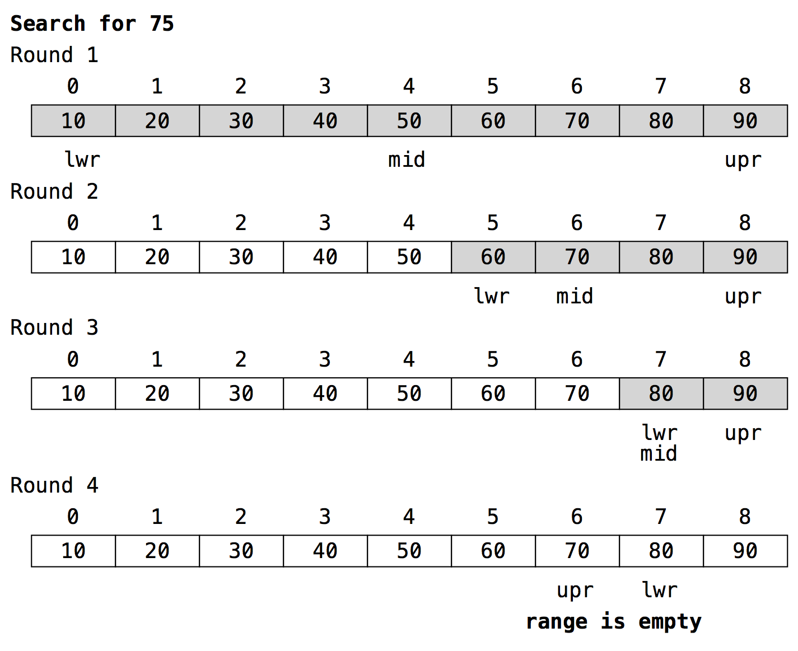
Efficiency Class Example: O(log n) Binary Search
Source: ref2
N = 9
75 == 50? (1)
75 == 70? (2)
75 == 80? (3)
(4)
log₂(9) = 3.17 <= 4
Any n between 9 and 16 will take at most 4 operations
Binary search of sorted data: O(log n)

Slide 24
Log₂(n) Example: Binary Search
size_t search( const array<int, 9> & c, int v )
{
size_t s = c.size();
size_t current = s / 2;
while( s != 0 )
{
if( v == c[current] ) return current;
if( s == 1 ) break;
s = ( s + 1 ) / 2;
if( v < c[current] ) current -= s / 2;
else current += s / 2;
}
return numeric_limits<size_t>::max();
}
Look for the loops!

Slide 25
Efficiency Class Examples
O(1): Constant time operations
O(n) : Linear time operations
O(log n): Logarithmic time operations
O(n²): Quadratic time operations

Slide 26
Efficiency Class Example: O(n²) Visit each cell of a Matrix
N = 4
4 X 4 Matrix
For each row r visit each column c
 | 0 | 1 | 2 | 3
0 | (0, 0) | (0, 1) | (0, 2) | (0, 3)
1 | (1, 0) | (1, 1) | (1, 2) | (1, 3)
2 | (2, 0) | (2, 1) | (2, 2) | (2, 3)
3 | (3, 0) | (3, 1) | (3, 2) | (3, 3)

Slide 27
Efficiency Class Example: O(n²) Visit each cell of a Matrix
// Defines an NxN matrix containing elements of type E
template<typename E, std::size_t N>
using Matrix = std::array<std::array<E, N>, N>;
// Determine if an NxN matrix is symmetrical along its major axis
template<typename E, std::size_t N>
bool isSymmetrical( const Matrix<E, N> & matrix )
{
for( std::size_t row = 0; row < matrix .size(); ++row )
for( std::size_t col = 0; col < matrix[row].size(); ++col )
{
if( ( row != col ) && ( matrix[row][col] != matrix[col][row] ) ) return false;
}
return true;
}
Look for the loops!
In this case, Nested loops!

Slide 28
What about memory requirement?
Source: ref1
So far, we have been speaking of running time
What about how much memory/space is occupied by a data structure?
Can also use O(n) concept:
Does memory usage go up proportionately to number of elements?

Slide 29
Acknowledgements
Most of the material contained herein has been authored by:
Dr. Anand Panangadan; California State University, Fullerton [ref1]
Professor Allen Holliday; California State University, Fullerton [ref2]

